Slide 1
Design and Analysis of Algorithms Sorting Algorithms
Week 8
By
Dr Rafiullah Khan
Senior Lecturer ICS/IT
The University of Agriculture Peshawar, Pakistan
For resources, please visit: https://rafiyz.github.io/courses/Algorithms/algo.htm

Slide 2
Agenda
Bubble Sort
Selection Sort
Insertion Sort

Slide 3
1. Bubble Sort
Idea:
Repeatedly pass through the array
Swaps adjacent elements that are out of order
Easier to implement, but slower than Insertion sort
i
1
2
3
n
8
4
6
9
2
3
1
j

Slide 4
Example
8
4
6
9
2
3
1
1
8
4
6
9
2
3
i = 1
j
i = 2
j
8
4
6
9
2
1
3
1
2
8
4
6
9
3
i = 1
j
i = 3
j
8
4
6
9
1
2
3
1
2
3
8
4
6
9
i = 1
j
i = 4
j
8
4
6
1
9
2
3
1
2
3
4
8
6
9
i = 1
j
i = 5
j
8
4
1
6
9
2
3
1
2
3
4
6
8
9
i = 1
j
i = 6
j
8
1
4
6
9
2
3
1
2
3
4
6
8
9
i = 1
j
i = 7
1
8
4
6
9
2
3
j
i = 1
j

Slide 5
Bubble Sort (Algorithm)
int i = 0, j = 0; for (i = 0; i < n; i++) {
for (j = 0; j < n - i - 1; j++) {
if (a[j] > a[j + 1]) {
Swap (a[j], a[j + 1]) } } }

Slide 6
Improved Bubble Sort
int i = 0, j = 0, flag; for (i = 0; i < n; i++) {
flag =0;
for (j = 0; j < n - i - 1; j++) {
if (a[j] > a[j + 1]) {
Swap (a[j], a[j + 1])
flag =1; } }
if (flag==0) break; }

Slide 7
2. Selection Sort
while some elements unsorted:
Find the smallest element in the unsorted section; this requires all of the unsorted items to be compared to find the smallest
Swap the smallest element with the first (left-most) element in the unsorted section
smallest so far:
45
36
22
13
16
21
45
22
79
47
60
74
36
66
94
22
45
57
38
29
81
the fourth iteration of this loop is shown here

Slide 8
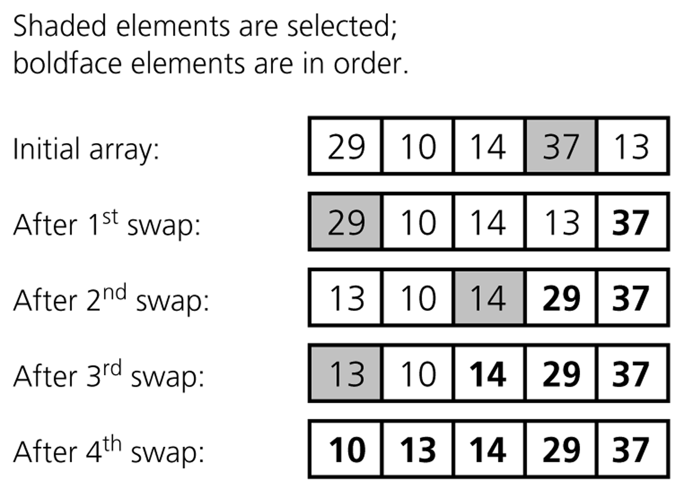
A selection sort of an array of five integers (using the algorithm in the textbook, in which the first part of array is unsorted and the second (bold) is sorted. Instead of the smallest element we have to look for the biggest element.

Slide 9
Selection Sort Algorithm
int i = 0, j = 0, iMin; for (i = 0; i < n-1; i++) {
iMin =;
for (j = i+1; j < n ; j++) {
if (a[j] < a[iMin]) iMin = j;
}
Swap (a[i], a[iMin]) }

Slide 10
3. Insertion Sort
Idea: like sorting a hand of playing cards
Start with an empty left hand and the cards facing down on the table.
Remove one card at a time from the table, and insert it into the correct position in the left hand
compare it with each of the cards already in the hand, from right to left
The cards held in the left hand are sorted
these cards were originally the top cards of the pile on the table

Slide 11
Insertion Sort
To insert 12, we need to make room for it by moving first 36 and then 24.
6
10
24
36
12

Slide 12
Insertion Sort
6
10
24
36
12

Slide 13
Insertion Sort
6
10
24
36
12

Slide 14
Insertion Sort
input array
5 2 4 6 1 3
at each iteration, the array is divided in two sub-arrays:
left sub-array
right sub-array
sorted
unsorted

Slide 15
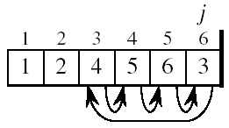
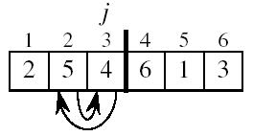
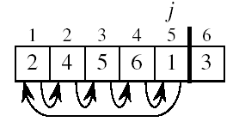
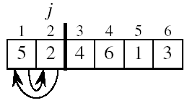
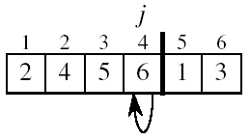
Insertion Sort

Slide 16
Insertion Sort Algorithm
int i, value, empty; for (i = 1; i < n-1; i++) {
value = a[i];
empty =i;
While (empty>0 && a[empty-1]>value) {
a[empty]=a[empty-1];
empty - - ;
}
a[empty]=value }

